Slide 1



FPT Software
ANDROID TRAINING
LESSON 2
Version 0.1

Slide 2
Agenda
Layout overview
LinearLayout
RelativeLayout
TableLayout
ListView
ScrollView
GridView
Gallery Control
Spinner Control

Slide 3
Main Layout Strategies
XML-based
  Declare layout in res/layouts/some_layout.xml
    Set various XML properties
    Use visual editor in Eclipse
  Load with setContentView(R.layout.some_layout)
Java-based
  Instantiate layout, set properties, insert sub-layouts
    LinearLayout window = new LinearLayout(this); window.setVariousAttributes(…); window.addView(widgetOrLayout);
  Load with setContentView(window)
This tutorial
  – Uses XML-based approach. However, attributes can be adapted for Java-based approach.

Slide 4
XML Layout Attributes
Idea
  Each Layout class has an inner class called LayoutParams that defines general XML parameters that layout uses. These parameters are always named android:layout_blah, and usually have to do with sizes and margins.
  Layout classes define more specific attributes. Many inherited from LinearLayout (which extends ViewGroup and View).
    Not named beginning with “layout_”
Example
  <LinearLayout
  android:layout_width="match_parent" android:layout_height="wrap_content"y _ gp_ android:gravity="center_horizontal" android:background="@color/color_1">…<LinearLayout>

Slide 5
Commonly Used Attributes
Size
  android:layout_height, android:layout_width
    match_parent: fill the parent space (minus padding)
    wrap content: use natural size (plus padding)
    An explicit size with a number and a dimension. See margins on next slide.
  android:layout_weight
    A number that gives proportional sizes. See example.

Slide 6
Commonly Used Attributes
Alignment
  android:layout_gravity
    How the View is aligned within containing View.
  android:gravity
    How the text or components inside the View are aligned.
  Possible values
    top, bottom, left, right, center_vertical, center_horizontal, center (i.e., center both ways), fill_vertical, fill_horizontal, fill (i.e., fill both directions), clip_vertical, clip_horizontal

Slide 7
Commonly Used Attributes
Margins (blank space outside)
  android:layout_marginBottom, android:layout_marginTop, android:layout_marginLeft, android:layout_marginRightandroid:layout marginRight
Padding (blank space inside)
  android:paddingBottom, android:paddingTop, android:paddingLeft, android:paddingRight
Units (e.g., "14.5dp")
  dp: density-independent pixels (scaled by device resol.)
  sp: scaled pixels (scaledbased on preferred font size)
  px: pixels
  in: inches
  mm: millimeters

Slide 8
Commonly Used Attributes
ID
  android:id
    Used if the Java code needs a reference to View
    Used in RelativeLayout so XML can refer to earlier ids
Colors
  android:background (color or image, for any Layout)
  android:textColor (e.g., for TextView or Button)
  Common color value formats
    "#rrggbb" "#aarrggbb", "@color/color name“
Click handler
  android:onClick
    Should be a public method in main Activity that takes a View (the thing clicked) as argument and returns void

Slide 9
LinearLayout
Idea
  Put components in a single row or single column
  By nesting, can have rows within columns, etc.
Most important XML attributes
  android:orientation
    "horizontal" (a row) or "vertical" (a column)
    horizontal is the default, so can be omitted for rows
  android:gravity
    How the Views inside are aligned
    Possible values
    top, bottom, left, right, center_vertical, center_horizontal, center (i.e., center both ways), fill_vertical, fill_horizontal, fill (i.e., fill both directions), clip_vertical, clip_horizontal

Slide 10
LinearLayout
android:layout_weight
  Assign android:layout_height to 0dp
  Use relative values for android:layout_weight
  Analogous approach to set widths
Example
<?xml version="1.0" encoding="utf-8"?>
<LinearLayout xmlns:android="…"xmlns:android …
android:orientation="vertical"
android:layout_width="match_parent"
android:layout_height="match_parent">
<TextView android:layout_width="match_parent" android:layout_height="0dp“
android:layout_weight="30" .../>
<TextView android:layout_width="match_parent“
android:layout_height="0dp“
android:layout_weight="30“ .../>
  <TextView android:layout_width="match_parent"
  android:layout_height="0dp"
  android:layout_weight="40" .../>
</LinearLayout>

Slide 11
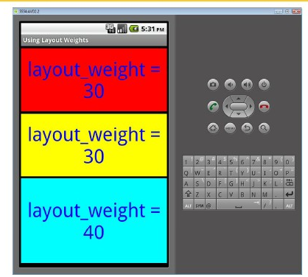
LinearLayout

Slide 12
RelativeLayout
Idea
  Give ids to 1 or more key components (id="@+id/blah")
  Position other components relative to those components
Most important XML attributes
  Aligning with container
    android:layout_alignParentBottom (and Top, Right, Left)
    android:layout_centerInParent (and centerHorizontal, centerVertical)
    These all take "true" or "false" as values
  Aligning with other component
    android:layout_alignBottom (and Top, Right, Left)
    android:layout_toLeftOf (and toRightOf), android:layout_above (and below)
    These all take existing ids as values

Slide 13
RelativeLayout
First component
  <Button id="@+id/button_1" android:layout_alignParentRight="true" …/>
Second component
  <Button android:layout_toLeftOf="@id/button 1" />
Result
Button 2
Button 1

Slide 14
TableLayout
Idea
  Put widgets or nested layouts in a grid. No borders.
  Like HTML tables, the number of rows and columns is determined automatically, not explicitly specified.
  Components are usually placed inside TableRow
Most important XML attributes (TableLayout)
  android:stretchColumns
    An index or comma-separated list of indexes. Specifies the column or columns that should be stretched wider if the table is narrower than its parent. Indexes are 0-based.
  android:shrinkColumns
    Column(s) that should be shrunk if table is wider than parent.
  android:collapseColumns
    Column(s) to be totally left out. Can be programmatically put back in later.

Slide 15
TableRow
Idea
  Goes inside TableLayout to define a row.
    Technically, elements between rows are permitted, but you can achieve same effect with a TableRow and android:layout_span.
Most important XML attributes of elements inside a TableRow
  android:layout_column
    Normally, elements are placed in left-to-right order. However, you can use android:layout_column to specify an exact column, and thus leave earlier columns empty.
  android:layout_span
    The number of columns the element should straddle. Like colspan for HTML tables.
    There is nothing equivalent to HTML’s rowspan; you must use nested tables instead

Slide 16
ListView control
Idea:
  The ListView control displays a list of items vertically.
The usage pattern for ListView:
  Writing a new activity that extends android.app.ListActivity. ListActivity contains a ListView.
  setListAdapter(): set the data for the ListView

Slide 17
ScrollView
In the case: you cannot fit all the views on one screen, it’s often useful to allow scrolling in order to fit more elements in a single activity.
Wrap the existing LinearLayout contents in a ScrollView:
  <ScrollView xmlns:android="http://schemas.android.com/apk/res/android"
  android:layout_width="match_parent" android:layout_height="match_parent"
  android:fillViewport="true" >
  <LinearLayout>
  <!-- Rest of code here -->
  </LinearLayout>
  </ScrollView>
Fillviewport Attribute
  cause the child views of a ScrollView to expand to the size of the display

Slide 18
GridView control
Idea:
  displays information in a grid.
The usage pattern for the GridView:
  to define the grid in the XML layout and then bind the data to the grid using an android.widget.ListAdapter.

Slide 19
The Gallery Control
Idea:
  Create a horizontally scrollable list control that always focuses at the center of the list.
The usage
  instantiate a Gallery either via XML layout or code:
  <Gallery
  android:id="@+id/galleryCtrl"
  android:layout_width="fill_parent"
  android:layout_height="wrap_content"
  />
  Using the Gallery control is similar to using a list control: call the setAdapter() method to populate data

Slide 20
The Spinner Control
Idea: like a dropdown menu.
Usage:
  You can instantiate a Spinner either via XML layout or code:
  <Spinner
  android:id="@+id/spinner"
  android:layout_width="wrap_content"
  android:layout_height="wrap_content"
  />
  Using the Spinner control is also similar to using a list control: call the setAdapter() method to populate data

Slide 21
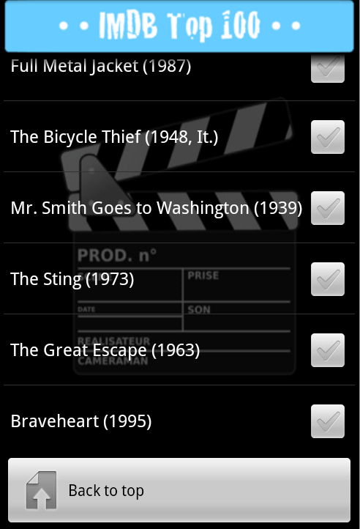
Homework
Create a application as following Layout

Slide 22
Thank you!

